Slide 1
Project presentation on :- RATINGS PREDICTION PROJECT
Submitted by :
VIVEK ANAND

Slide 2
Table Of Contents :-
1. Introduction
1.1 Problem Statement and understanding
2. EDA steps and Visualization
3. Steps and assumptions used to complete the project
3.1 Data Pre-processing Done
3.2 Set of assumptions related to the problem under consideration
4. Model Dashboard
5. Finalized Model
6. Conclusion
7. Acknowledgement

Slide 3
INTRODUCTION
Problem statement and understanding
We have a client who has a website where people write different reviews for technical products. Now they are adding a new feature to their website i.e. The reviewer will have to add stars(rating) as well with the review. The rating is out 5 stars and it only has 5 options available 1 star, 2 stars, 3 stars, 4 stars, 5 stars. Now they want to predict ratings for the reviews which were written in the past and they don’t have rating. So we, we have to build an application which can predict the rating by seeing the review.

Slide 4
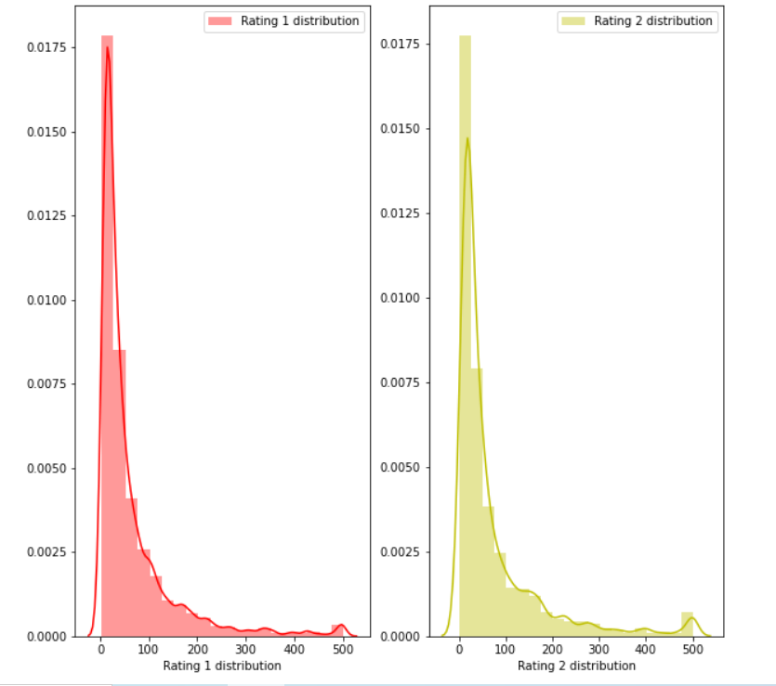
Rating 1 and and Rating 2 distribution before cleaning the reviews:

Slide 5
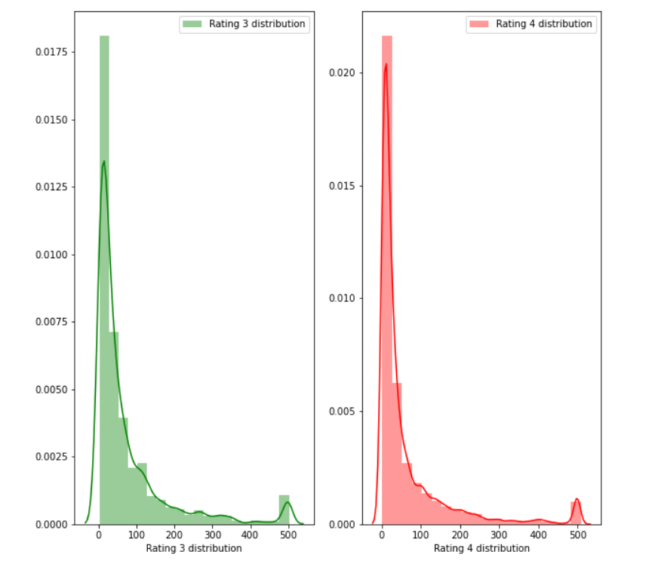
Rating 3 and and Rating 4 distribution before cleaning the reviews:

Slide 6
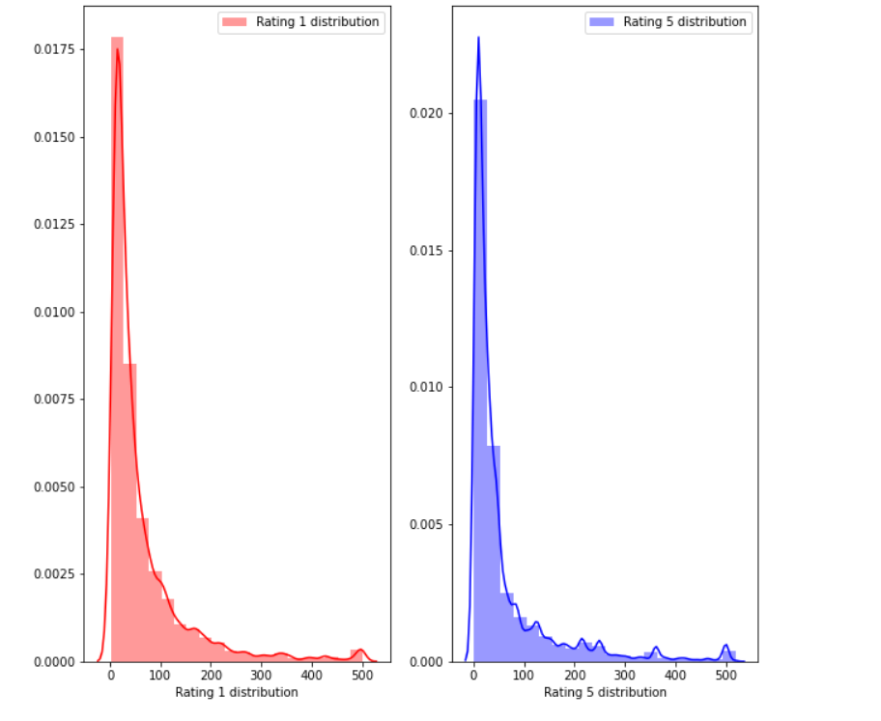
Rating 1 and and Rating 5 distribution before cleaning the reviews:

Slide 7
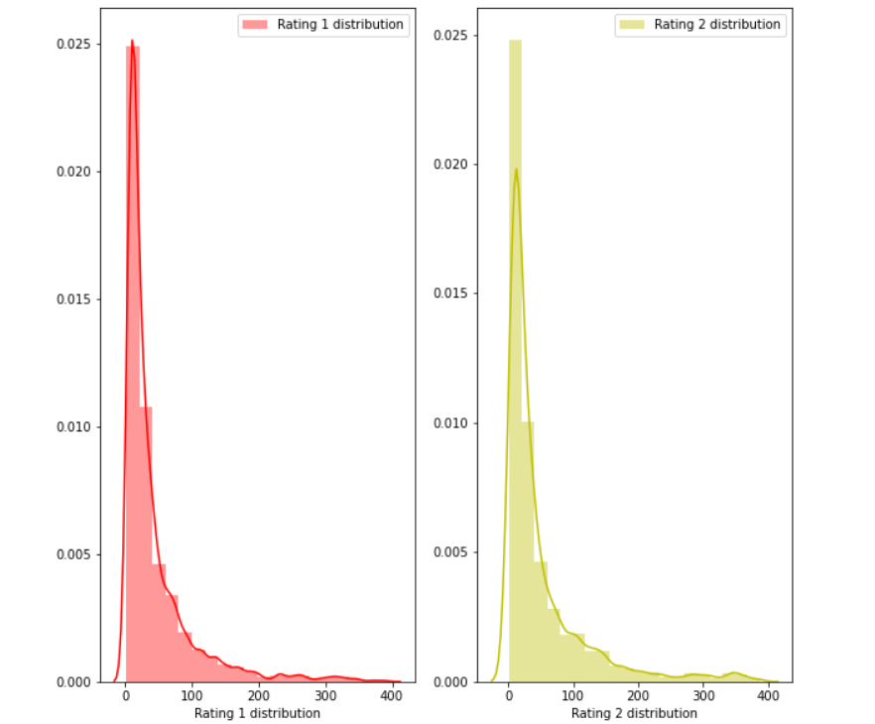
Rating 1 and and Rating 2 distribution after cleaning the reviews:

Slide 8
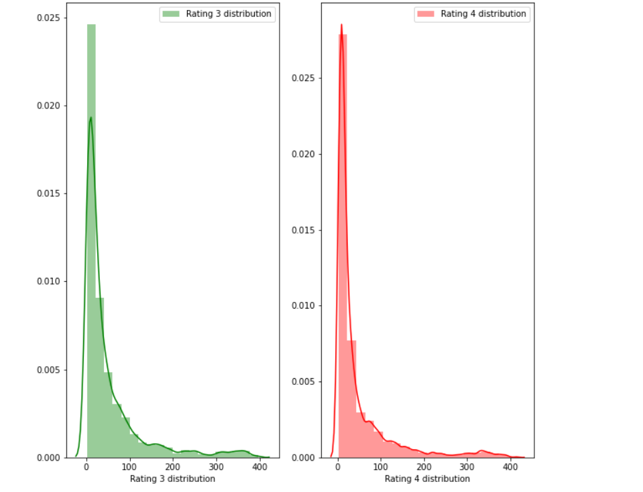
Rating 3 and and Rating 4 distribution after cleaning the reviews:

Slide 9
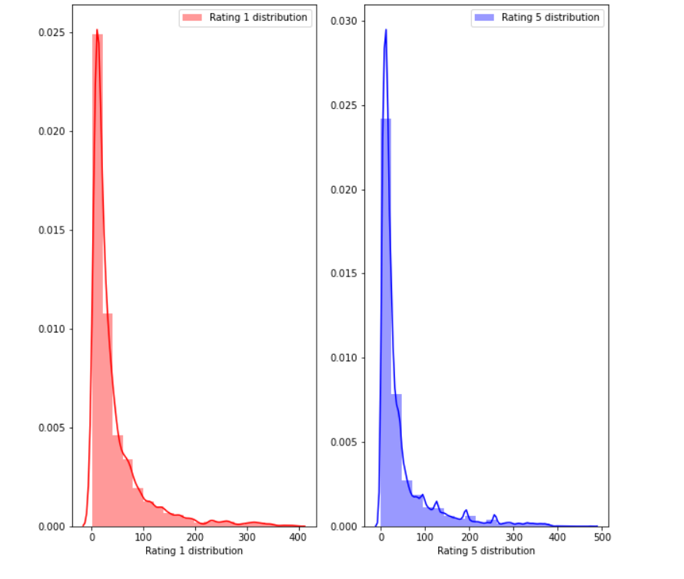
Rating 1 and Rating 5 distribution after cleaning reviews:

Slide 10
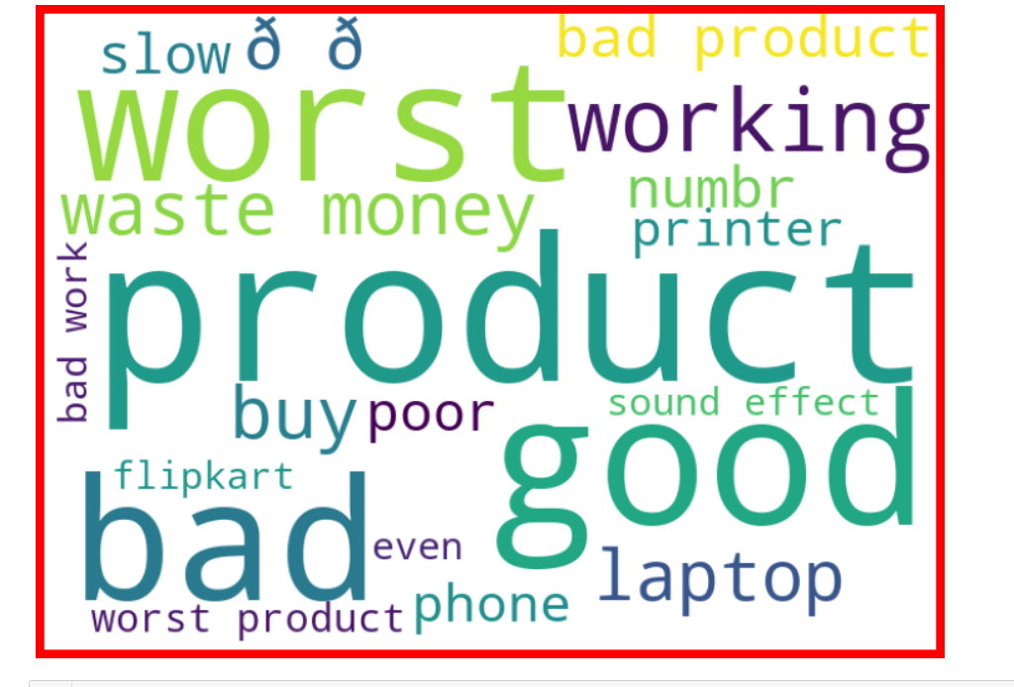
Getting sense of review Loud words in Rating 1:

Slide 11
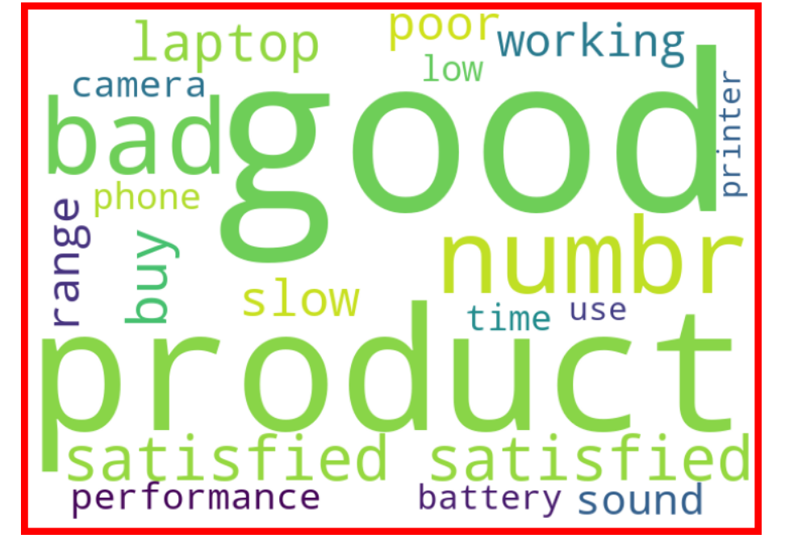
Getting sense of review Loud words in Rating 2:

Slide 12
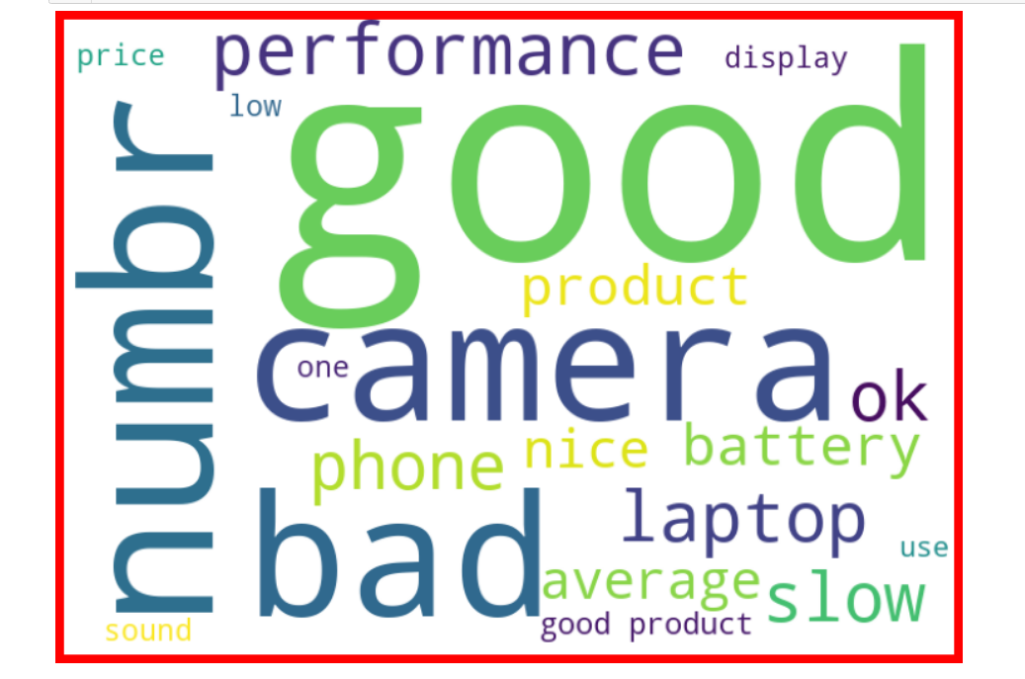
Getting sense of review Loud words in Rating 3:

Slide 13
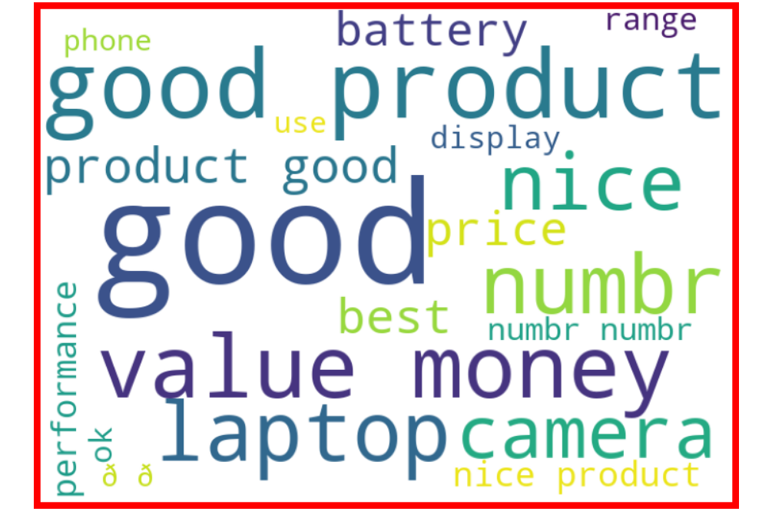
getting sense of review Loud words in Rating 4:

Slide 14
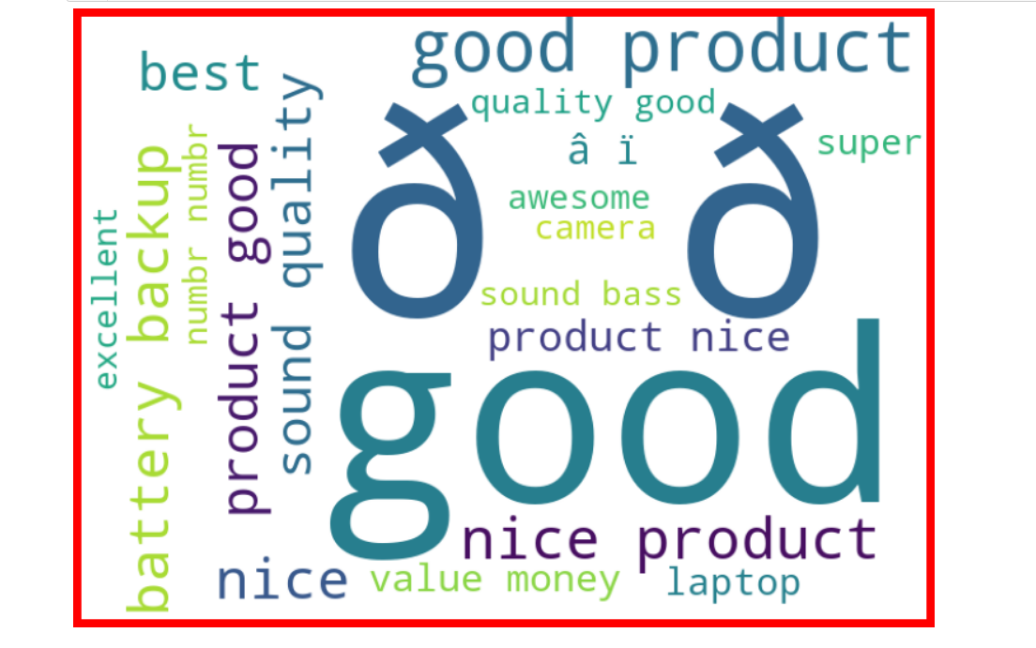
getting sense of review Loud words in Rating 5:

Slide 15
Data Preprocessing Done
We first looked for the null values present in the dataset. We noticed that there were no null values present in our dataset. Then we performed text processing. Data usually comes from a variety of sources and often in different formats. For this reason transforming your raw data is essential. However, this is not a simple process, as text data often contains redundant and repetitive words. This means that processing the text data is the first step in our solution. The fundamental steps involved in text preprocessing are, Cleaning the raw data Tokenizing the cleaned data.

Slide 16
Preprocessing involved the following steps:
Removing Punctuations and other special characters
Removing Stop Words
Stemming and Lemmatising
Applying tfidf Vectorizer
Balancing the dataset through smote technique

Slide 17
Some very large length comments can be seen, in our dataset. These pose serious problems like adding excessively more words to the training dataset, causing training time to increase and accuracy to decrease! Hence, a threshold of 400 characters will be created and only comments which have length smaller than 400 will be used further.
Hence, after removing comments longer than 400 characters, we are still left with 115893 comments, which seems enough for training purposes.

Slide 18
Set of assumptions related to the problem under consideration
By looking into the target variable label we assumed that it was a Multiclass classification type of problem.
We observed that dataset was imbalance so we will have to balance the dataset for better outcome.

Slide 19
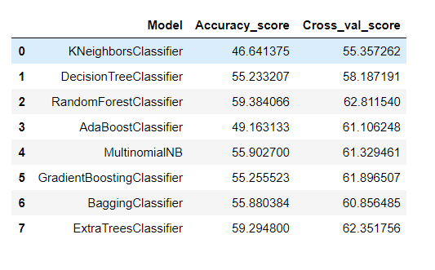
Model Dashboard​
We observe that Random forest classifier is giving is best results so we save it as our final model.

Slide 20
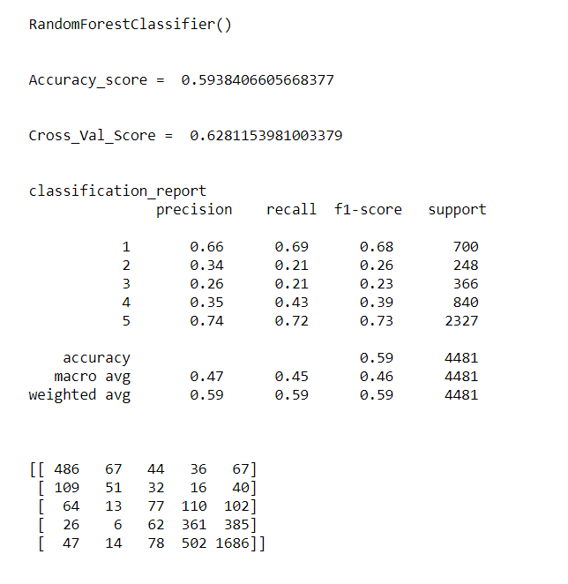
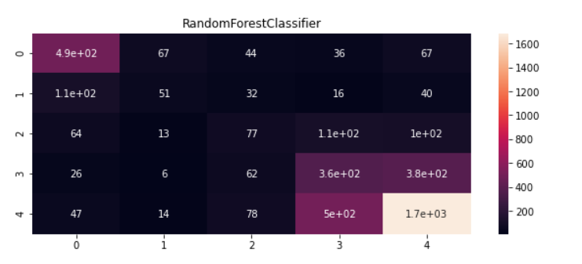
Finalized Model
We interpreted that Random forest classifier model was giving us the best results with the accuracy score of 59.38 and comparatively better f1-score so we saved it as our final model.

Slide 21
Conclusion
In this project we have tried to detect the Ratings in commercial websites on a scale of 1 to 5 on the basis of the reviews given by the users. We made use of natural language processing and machine learning algorithms in order to do so. We interpreted that Random forest classifier model is giving us best results.

Slide 22
Acknowledgement
I would like to express my special thanks of grattitude to the sources Medium, Towards Data Science and Google which helped me to accomplish this project.

